Slide 1



Chest X-ray Abnormalities Detection

Slide 2
Kulkarni Ganesh Shivajirao
ED16B016
InuAid Solutions Pvt.Ltd
Guide : Ganapathy Krishnamurthi

Slide 3
VinBig Challenge
Object Detection Task
Classifying thoracic lung diseases
Localizing critical findings
15000 total DICOM Images
14 classes with BBox

Slide 4
Annotations
Given format of annotations : [xmin ymin xmax ymax] (pixels)
Used DICOM Images for training Faster RCNN model
Converted annotations into standard COCO format
Used Healthy images as background class
Given full boxes to negative images

Slide 5
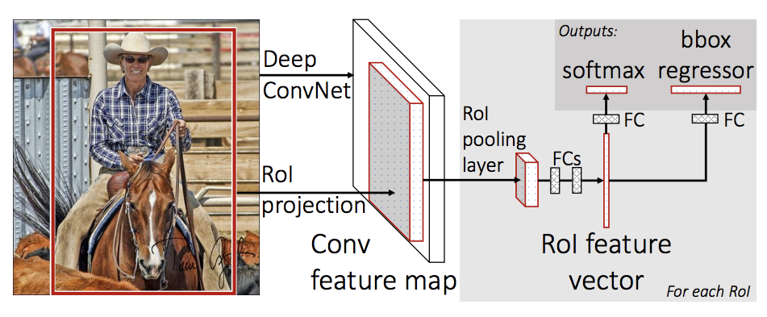
Faster RCNN
RCNN extracts the regions from the input image with the selective search
Faster-RCNN uses Region of Interests (ROI)

Slide 6
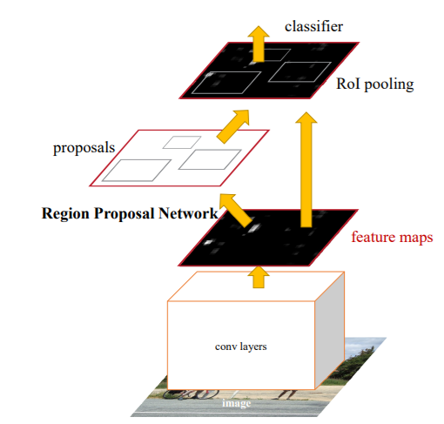
Faster RCNN

Slide 7
Training
Used 12000 DICOM Images for training and 3000 for Validation
Provide annotation in COCO format with json file
Number of classes : 15 (including background)
Used Resnet50 backbone pretrained on ImageNet
Learning rate : 0.001

Slide 8
Training
Batch size : 64
Images size : 512
Kept other hyperparameters as default

Slide 9
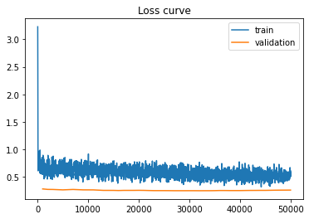
Results

Slide 10
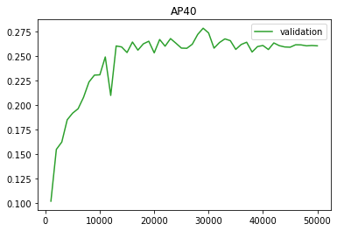
Results

Slide 11
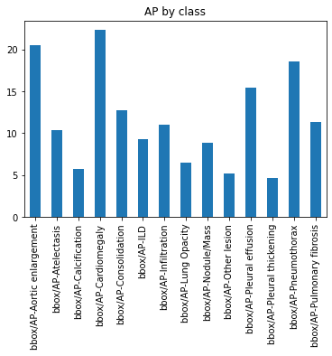
Results

Slide 12
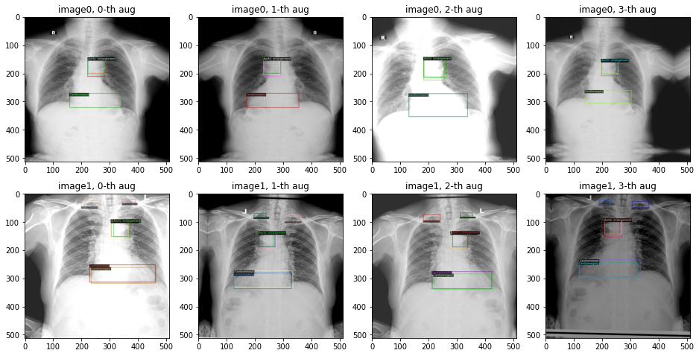
Results

Slide 13
Results
Test Faster RCNN model on Kaggle test data
mAP score on validation : 0.275
Generated results with Ensemble method
Found public score : 0.155
Private score: 0.185

Slide 14
Thank You

